Slide 1

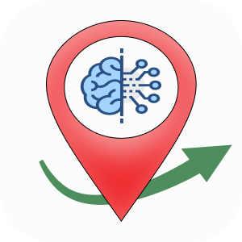
TADH TAnakul-DHaki
Specifications: Prof. Jalel Ben Othman
Supervisors : Prof. Jalel Ben Othman
Dr. Ali Benzerbadj
Ahmed Nour ABDESSELAM
Hala Hachemane

Slide 2
OUTLINE
Introduction
Why flutter?
Routing Criterias
Live Demo
Key benefits
Improvements and perspectives

Slide 3
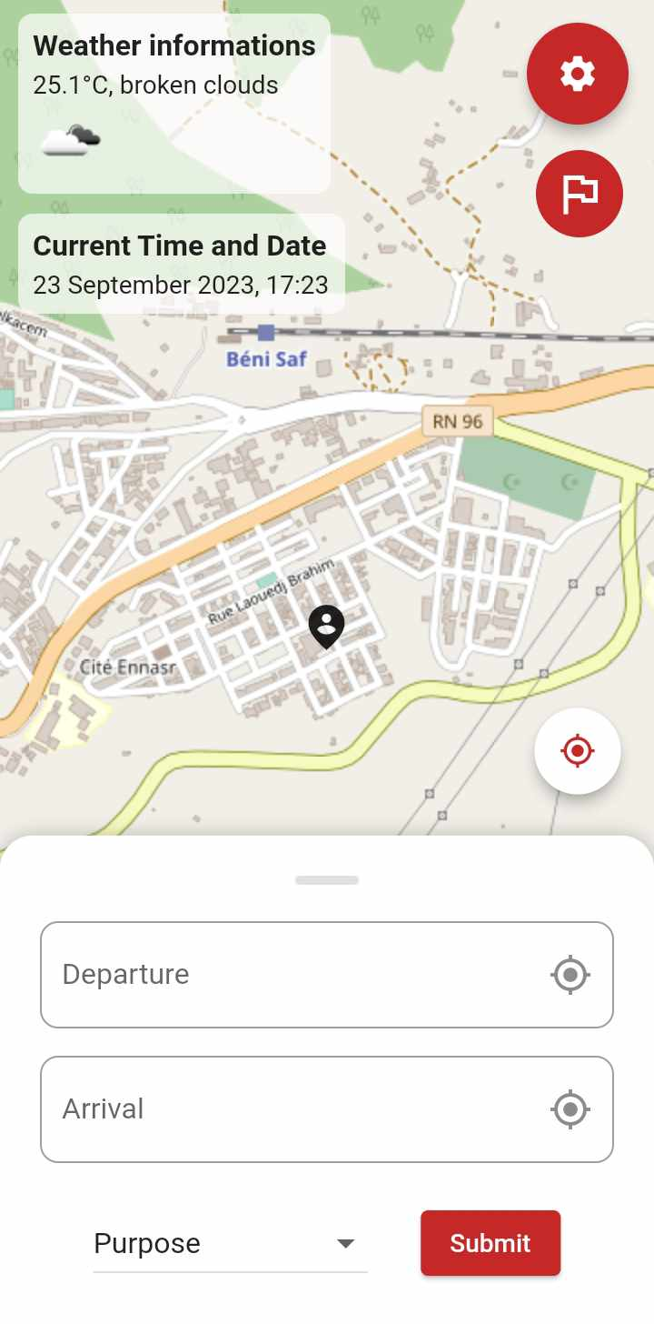
INTRODUCTION
TADH App
Streamlines Urban Mobility
Delivers Real-Time Transportation Updates
Streamlines Trip Planning
Seamlessly Offers Personalized Transportation Options Based On:
Health Conditions
Weather
Duration
Purpose
Optimizes Each Journey to Suit Unique Requirements
Improves Abu Dhabi's Urban Mobility Through a Decentralized Approach

Slide 4

Why Flutter?
TADH Originally designed for Android (H. Hachemane)
Cross-Platform Advantage: flutter offers cross-platform compatibility, allowing app development for both Android and iOS from a single codebase
Stunning User Interfaces: Harness Flutter's widgets and customizable designs to create visually captivating and consistently appealing user interfaces
Swift Development: Expedite and enhance development with Flutter's hot reload feature, ensuring a faster and more efficient workflow
Community-Driven Open Source: Become a part of a vibrant developer community and benefit from regular updates with Flutter's open-source framework

Slide 5
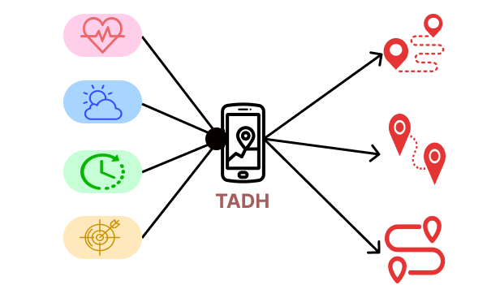
Routing Criterias

Slide 6
Live Demo

Slide 7
Key Benefits
Integrate TADH into Your Daily Routine for the Following Benefits:
Informed Decision-Making: Make choices that align with your lifestyle and physical conditions
Enhanced Well-being: Prioritize physical activity and health
Time Optimization: Reduce travel time and streamline your daily schedule
Weather Resilience: Stay ready for changing weather conditions
Goal-Oriented Journeys: Align your travels with your intentions and objectives
Enhancing Urban Mobility: TADH's Impact in Abu Dhabi

Slide 8
Improvements and perspectives
Seamless Public Transportation: Integrating TADH with Google Maps for effortless public transit planning (payable option).
Efficient Carpooling: Establishing connections with existing ride-sharing apps or creating a new one for convenient carpooling.
Exploring Novel Transportation: Investigating innovative transportation solutions.
Environmentally-Friendly Routes: Promoting eco-friendly routing options.
Personalized Machine Learning: Utilizing machine learning to tailor the app to each user's needs.

Slide 9
Thank you, for your attention

